Slide 1


Slide 2
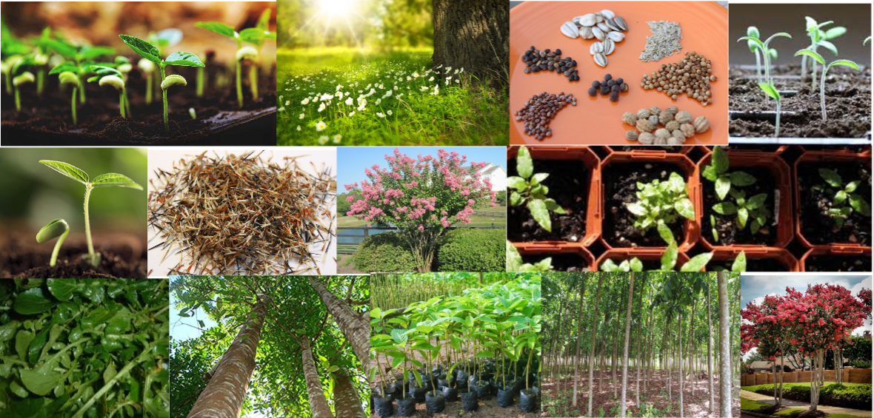

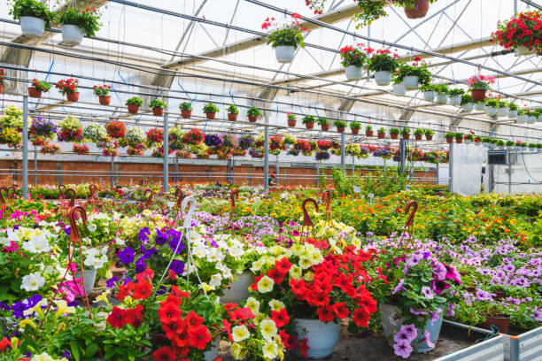
2
Roots & Shoots
Information of Group Members:
Sadman Rafid (011181029)
Badruddoza Dhrubo (011201010)
Mahfuja Maliha (011201034)
Course Information
Course Name : Database Management System Laboratory Course Code : CSE 3522
Course Teacher : Sadia Islam
Section : C

Slide 3

3
Introduction
Unique
Online Based Nursery Project
we provided jar ,soil fertilizer, chemical from our nursery to grow good plant
Advisor gives advice
Everyone can visited our nursery to click this "LEAF" icon without any restrictions.

Slide 4
4
Motivation
At Roots & Shoots, our motivation is to provide a unique and enjoyable buying experience for plant enthusiasts. We believe that plants have the ability to enhance our lives and bring joy and beauty to our homes and workspaces. Our goal is to make the process of buying plants as easy and enjoyable as possible, while also providing high-quality products and exceptional customer service.

Slide 5
5
Aims & Objectives
* Customer Delight
* Green Lifestyle Advocacy
* Curated Selection
* Educational Empowerment
* Community Building
* Exceptional Customer Service
* User-Friendly Platform
* Quality Assurance

Slide 6
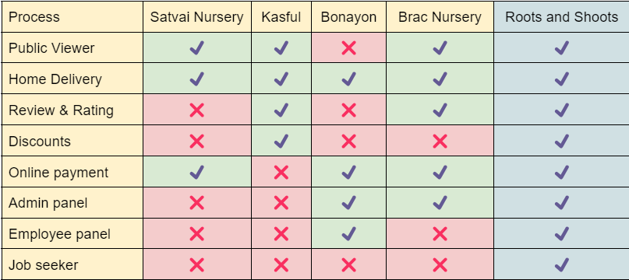
Existing System Analysis
6

Slide 7

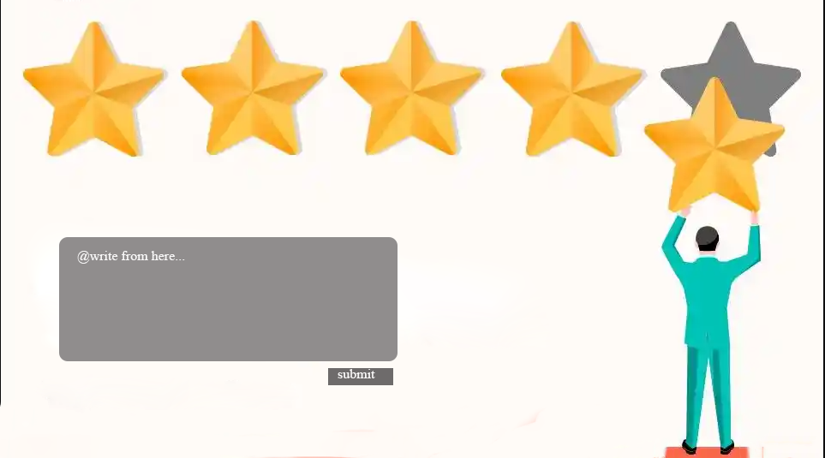

Special Features
7
Provided home service with our nursery rules
Customers can give review and rating
Provide Discount

Slide 8
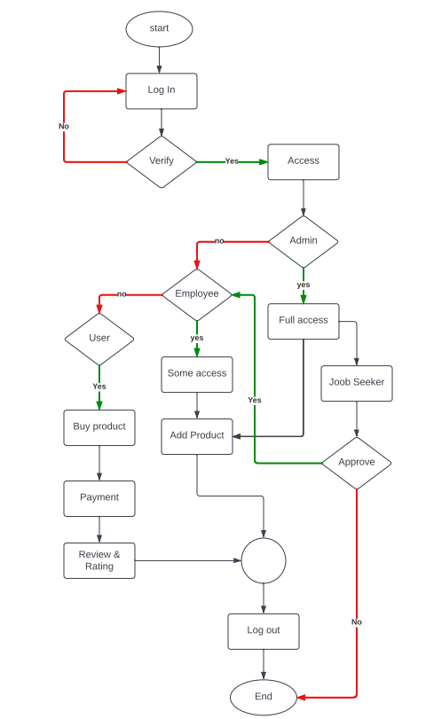
Flow chart
8

Slide 9
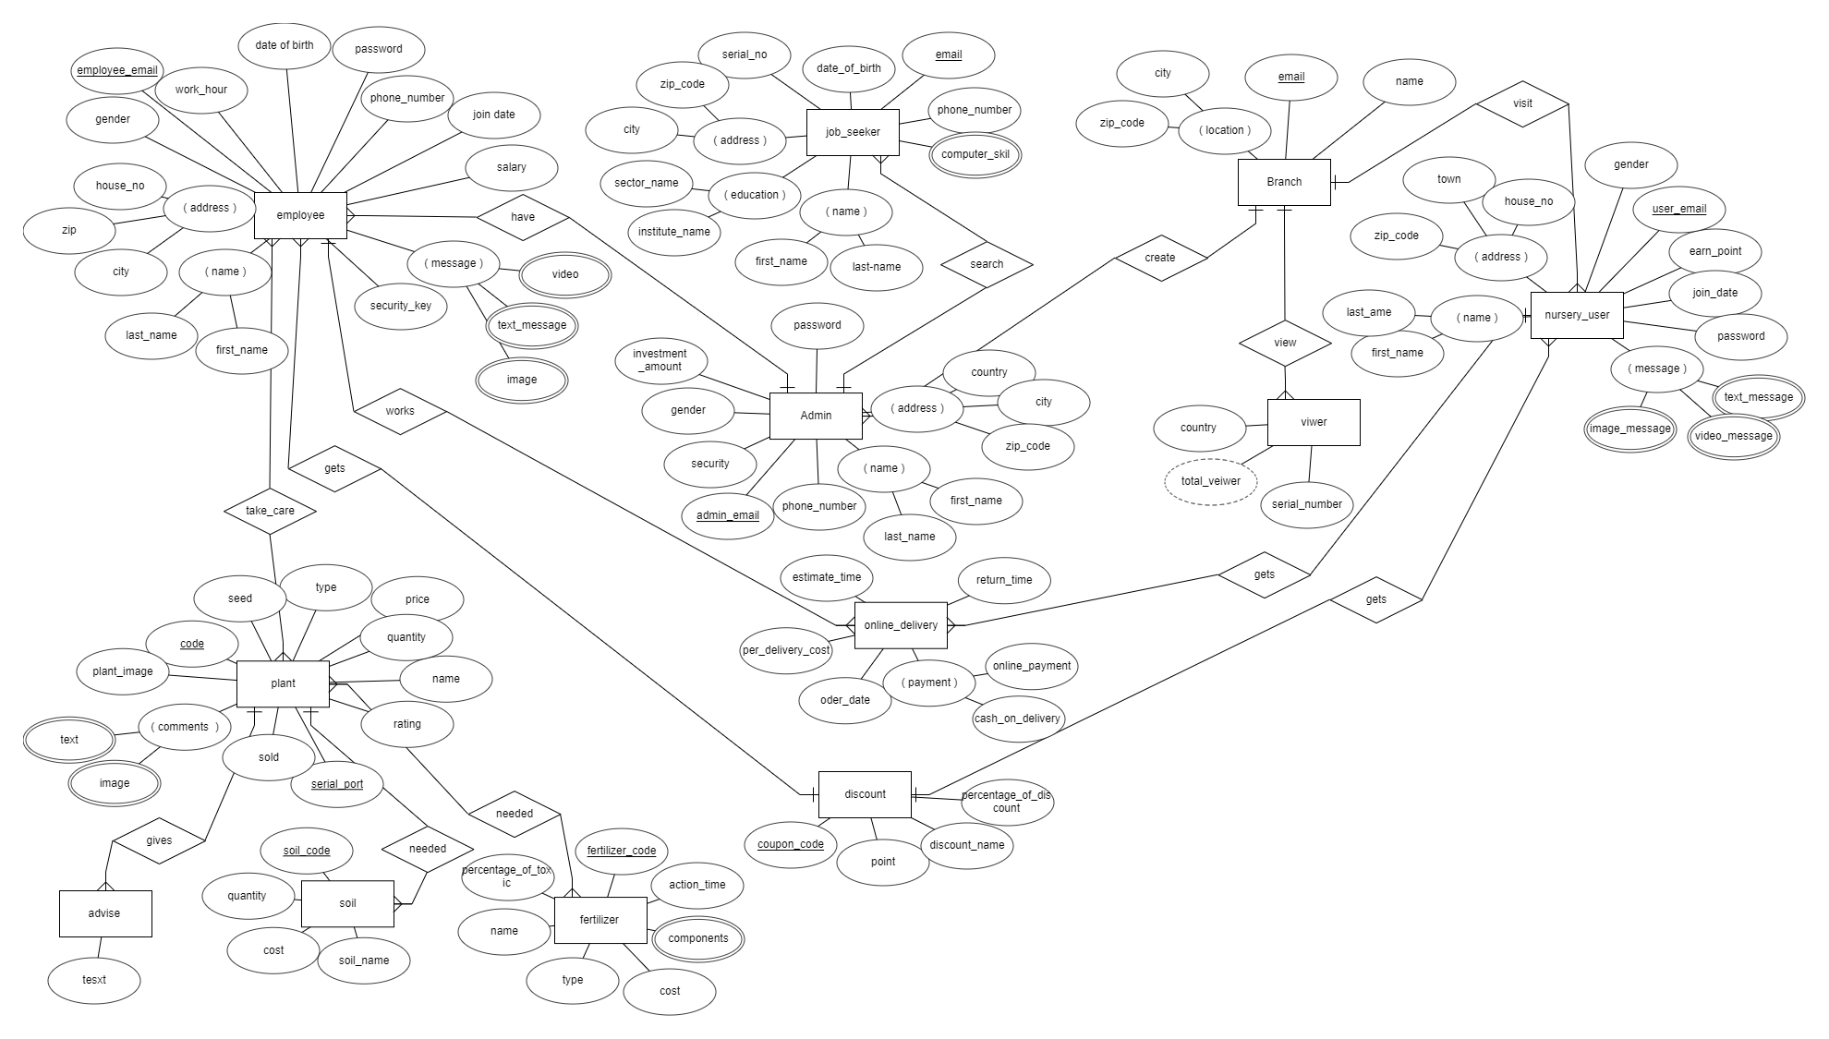
ER Diagram
9

Slide 10
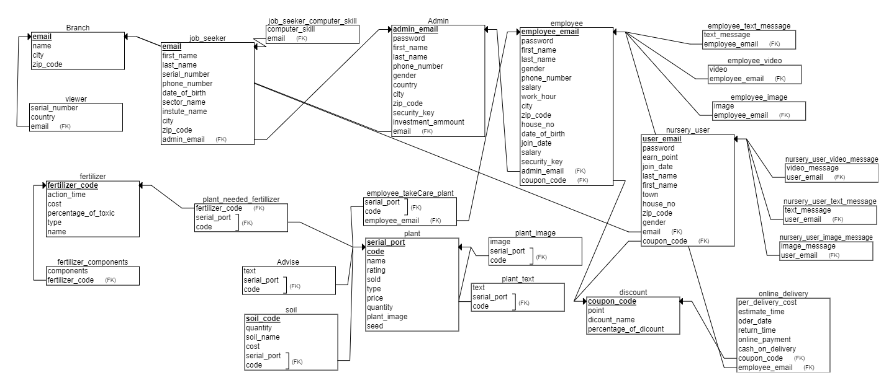
Schema Design
10

Slide 11
Work Distribution
11
Initial Stage
Design relational schema
Create database
Insert demo data
Week 01
Sadman,Dhrubo,Maliha
Intermediate Stage
MYSQL
Complete frontend
Project connected with database by PHP
Week 02
Sadman,Dhrubo,Maliha
Final Stage
Insert data from website
Check and debug
Project complete without any bug
Week 03
Sadman,Dhrubo,Maliha

Slide 12
12
Language & Platform
The database management system for the online plants selling system will be developed using SQL (Structured Query Language). Platform will be XAMP

Slide 13
13
Conclusion
Roots & Shoots aims to bring nature into people's homes and lives through a seamless plant buying experience. By providing access to high-quality, sustainably grown plants, Roots & Shoots hopes to inspire people to connect with nature and to create a more sustainable future.

Slide 14


